Slide 1
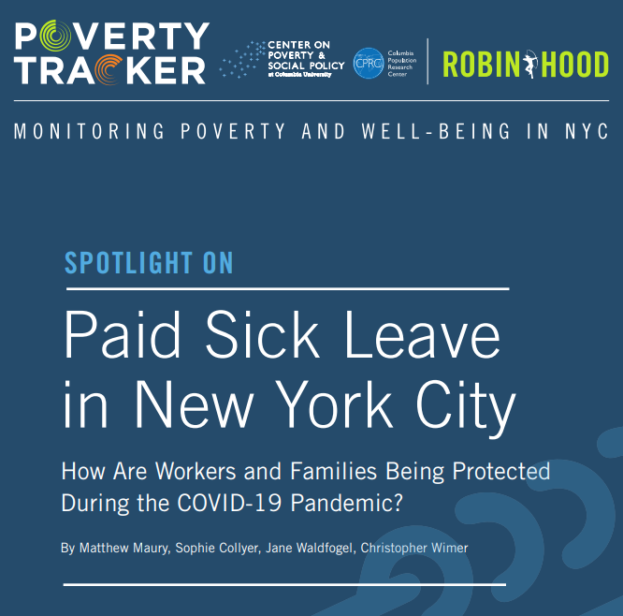
Access at povertycenter.columbia.edu
https://www.robinhood.org/programs/special-initiatives/poverty-tracker/
Send inquiries to Matt Maury: matthew.maury@columbia.edu

Slide 2
Overview
Laws on the books (prior to Covid-19 pandemic)
Federal
State
Local
Rates of paid sick leave uptake before the crisis
Using Poverty Tracker data from 2018
New emergency legislation which expands paid time off
Federal Emergency Paid Sick Leave Act
New York State’s recently enacted paid sick leave legislation

Slide 3
Federal Paid Sick/Family Leave Legislation
No federally mandated paid sick leave (prior to Covid-19)
Out of 22 countries ranked highly in terms of economic and human development, the US was the only that did not guarantee workers paid sick leave.
81% of full-time workers in private industry have access to paid sick leave, while only 35% of part-time workers do.
43% of workers in the bottom wage quartile had access to paid sick leave compared to 89% in the top quartile.

Slide 4
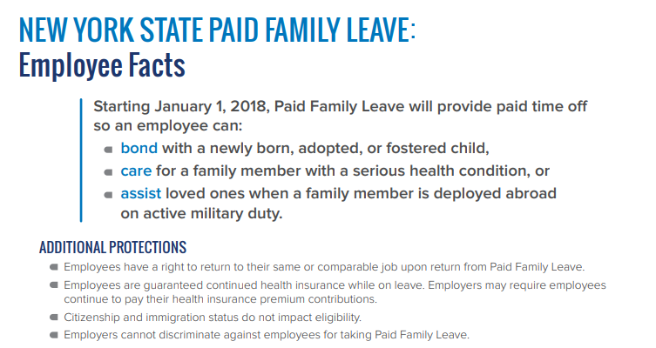
New York State Paid Sick/Family Leave Legislation
No state mandated paid sick leave (prior to Covid-19)
New York State’s Paid Family Leave Act
Passed in 2018
Provides employees with 60 percent of their regular pay for 10 weeks to care for a new child or for loved ones suffering from a serious illness.

Slide 5
New York City Paid Sick/Family Leave Legislation
New York City’s Paid Safe and Sick Leave Law
Passed in 2014
Provides employees with up to 40 hours, or about five days, of paid sick leave.
Employees receive 1 hour of paid sick leave for every 30 hours worked.
Who is covered?
Those who work for employers with 5 or more employees
Who is not covered?
Employees who work “off the books”
Independent contractors
Employees who work fewer than 80 hours per year
Federal work study employees

Slide 6
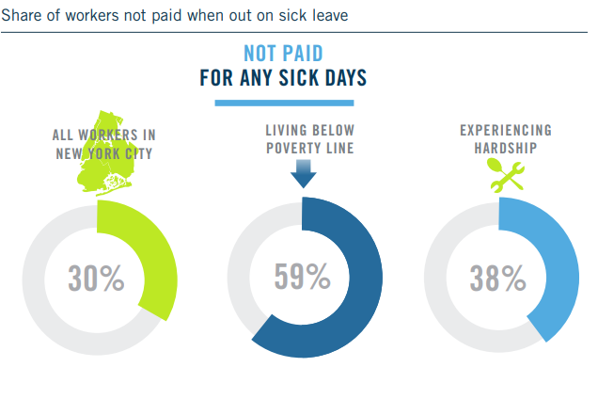
Results from the Poverty Tracker:

Slide 7
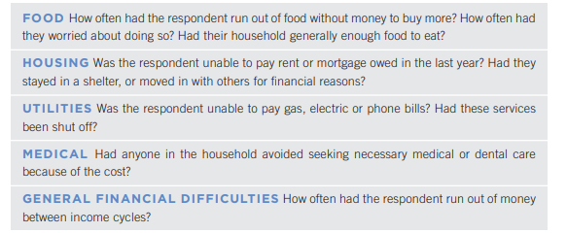
How do we define a material hardship?

Slide 8
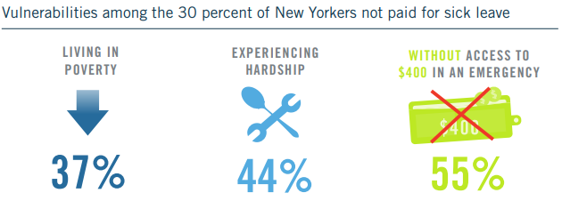
Results from the Poverty Tracker:

Slide 9
Emergency Paid Sick and Family Leave Expansions in Response to Covid-19
The Federal Emergency Paid Sick Leave Act
Applies to those working for employers with fewer than 500 employees.
Employers with fewer than 50 employees can have the requirement waived, meaning people working for small employers are not guaranteed protection.

Slide 10
Emergency Paid Sick and Family Leave Expansions in Response to Covid-19
The Federal Emergency Paid Sick Leave Act
The law mandates:
For those quarantined, have been advised by a healthcare provider to self-quarantine, or are experiencing symptoms of COVID-19 and are seeking a medical diagnosis.
Up to 10 days, or 80 hours, of paid sick leave
For those who are caring for a sick family member or a child whose school or daycare has closed.
Up to 10 days, or 80 hours, of two-thirds pay
After 10 days employees continue to receive two-thirds of their pay under the expanded Emergency Family and Medical Leave Expansion Act for an additional 10 weeks.

Slide 11
Emergency Paid Sick and Family Leave Expansions in Response to Covid-19
New York State’s expanded paid sick leave law mandates
Fourteen days of paid sick leave for quarantined workers in businesses with 100 or more employees.
Five days of paid sick leave for workers in businesses with 11-99 employees or fewer than 10 employees and more than $1 million in net income.
Those working for an employer with fewer than 10 employees and less than $1 million in net income are not guaranteed any paid sick leave. In New York City, these employees are guaranteed only the number of hours of sick leave that they have accrued (up to 40 hours) through the 2014 New York City paid sick leave law.

Slide 12
Emergency Paid Sick and Family Leave Expansions in Response to Covid-19
New York State’s expanded paid sick leave law mandates
After employees have utilized their paid sick leave under the state law, they can apply for paid family leave and disability benefits for up to 100 percent of their pay.
Additionally, the state law expands coverage of paid family leave for employees who have a child under mandatory or precautionary quarantine.

Slide 13
New York State Paid Sick Leave Law
Similar to NYC paid sick leave law.
Employees of employers with 5 or more employees will be provided with up to 40-56 hours of paid sick leave a year.
It does not preempt or diminish existing city- or county-level paid sick leave laws. Days can not be stacked with those guaranteed under city law.

Slide 14
How do these policies interact?
New York State’s emergency paid sick leave law cannot be stacked on top of the federal law.
The state and federal guarantees can, however, be combined with the city’s paid sick leave benefits.

Slide 15
Drawbacks of current legislation?
Those working for smaller employers have less guaranteed paid sick time than those working for larger employers.
Those caring for children or family members will be left with just 60-67% of their pay.
Those who are sick for longer than the 10-19 days people are entitled to may not have enough paid sick time to keep them home .

Slide 16
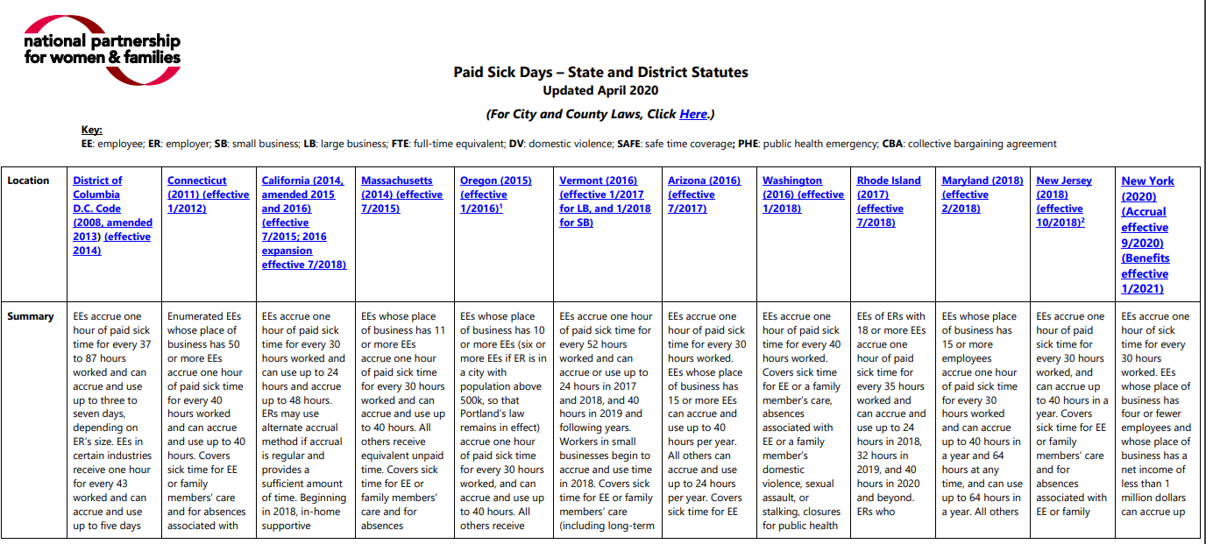
Useful Links
Paid Sick Leave laws by state/city/county - https://www.nationalpartnership.org/our-work/resources/economic-justice/paid-sick-days/paid-sick-days-statutes.pdf
Paid Family Leave by state https://www.nationalpartnership.org/our-work/resources/economic-justice/paid-leave/state-paid-family-leave-laws.pdf

Slide 17
Useful Links
NYC Paid Safe and Sick Leave Law Facts
https://www1.nyc.gov/site/dca/about/paid-sick-leave-FAQs.page
New York State Paid Family Leave Facts
https://www.ny.gov/sites/ny.gov/files/atoms/files/PaidFamilyLeave_EmployeeFactSheet.pdf
New York State Paid Sick and Family Leave Expansion Facts
https://paidfamilyleave.ny.gov/COVID19
US Paid Sick and Family Leave Expansion Facts
https://www.dol.gov/agencies/whd/pandemic/ffcra-employee-paid-leave
States/cities that have enacted Covid-specific laws or issued Covid-specific guidance:
https://www.natlawreview.com/article/state-law-round-covid-19-state-and-local-paid-sick-leave-law-developments-us

